Slide 1
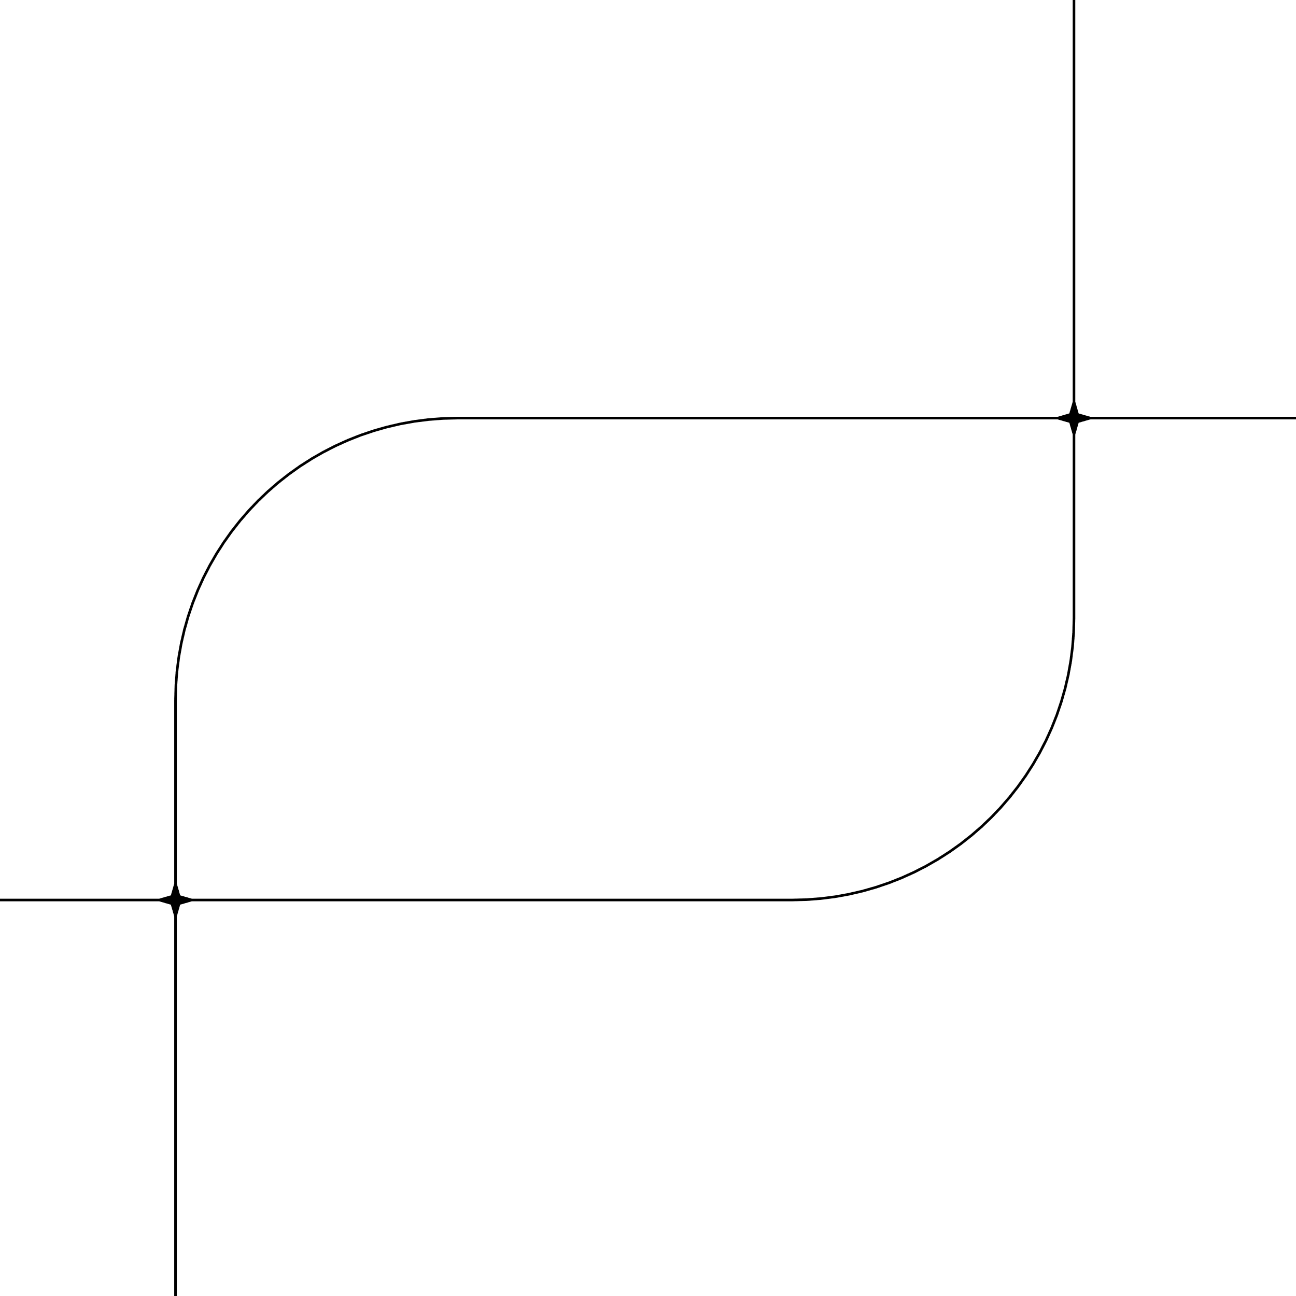

BANK LOAN CASE STUDY

Slide 2
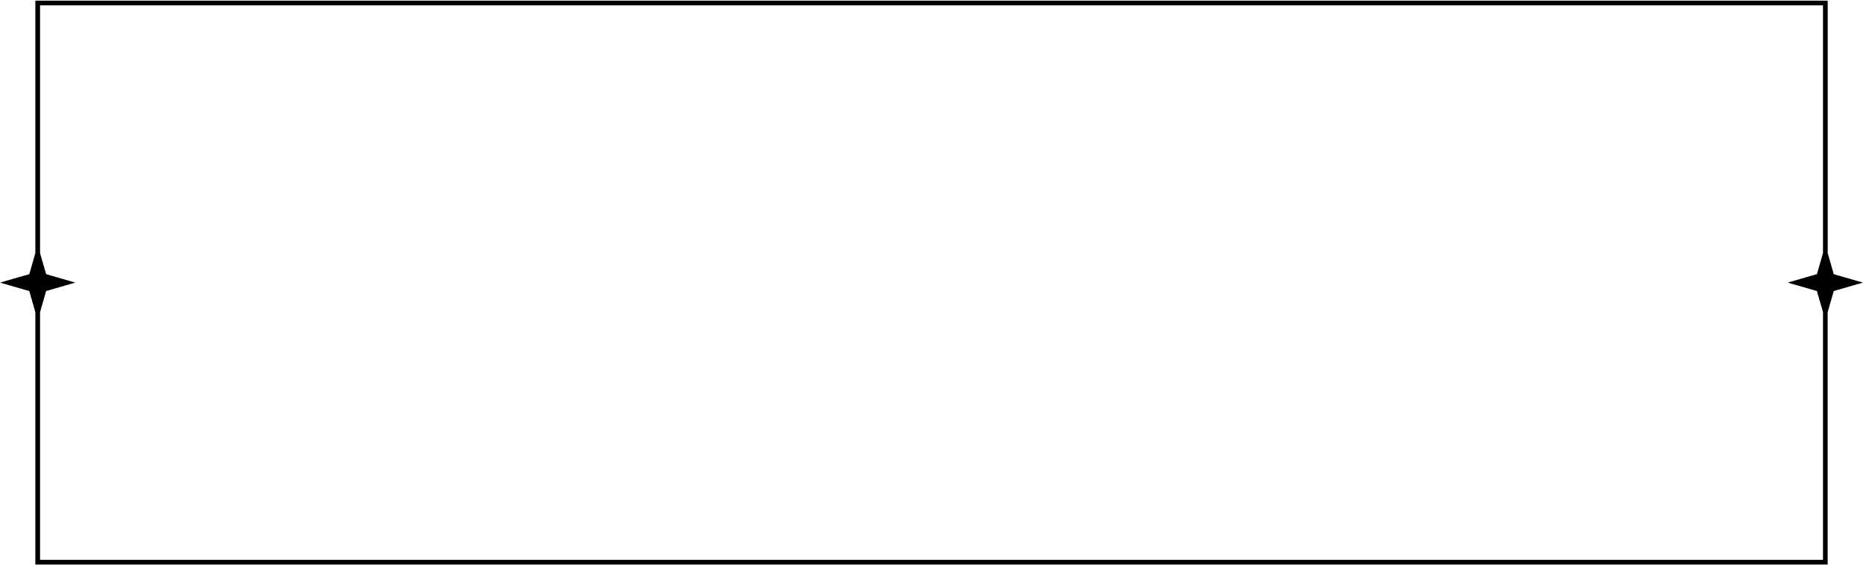
CONTENTS
PROJECT DESCRIPTION
APPROACH
TECH STACK USED
INSIGHTS
RESULTS

Slide 3

PROJECT DESCRIPTION
This project aims to explore the deep analysis of bank loan to understand what goes behind it
our main task is to use EDA(exploratory data analysis) to analyze patterns in the data and ensure that capable applicants are not rejected.
When a customer applies for a loan, we might possibly face two risks:
If the applicant can repay the loan but is not approved, the company loses business.
If the applicant cannot repay the loan and is approved, the company faces a financial loss.

Slide 4
The dataset I'll be working with contains information about loan applications. It includes two types of scenarios:
Customers with payment difficulties: These are customers who had a late payment of more than X days on at least one of the first Y installments of the loan.
All other cases: These are cases where the payment was made on time.
When a customer applies for a loan, there are four possible outcomes:
Approved: The company has approved the loan application.
Cancelled: The customer cancelled the application during the approval process.
Refused: The company rejected the loan.
Unused Offer: The loan was approved but the customer did not use it.
MY goal in this project is to use EDA to understand how customer attributes and loan attributes influence the likelihood of default.

Slide 5
APPROACH
STEP-1
STEP-2
STEP-3
STEP-4
Data Cleaning
Data Analysis
Data collection & Data modelling
Data visualization & Data Insights
Involves
finding out blank cells, handling null values
removing out columns having null proportion more than 45%
handling missing values using descriptive statistics
involves sorting data to make it less complicated while performing tasks and identifying patterns, trends &insights with the information, it can be used to make decisions such as denying the loan, reducing the amount of loan, or lending at a higher interest rate to risky applicants
involves collecting data and performing the given tasks Using statistical methods that can predict outcomes or identify trends & patterns
involves Creating reports and charts to communicate findings Extracting actionable insights from the data Creating documentation so anyone going through can understand the data analysis process

Slide 6
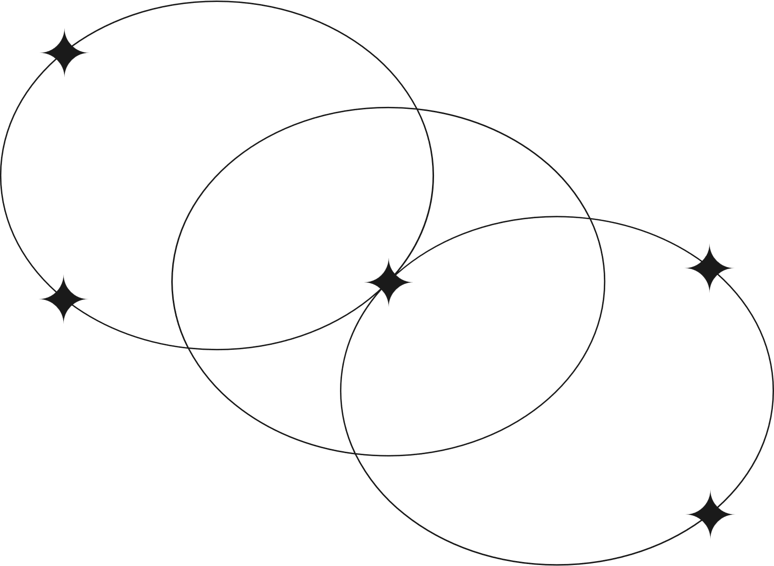

Tech Stack Used
Microsoft Excel : To do Data analyst process
Word : To Document insights & results
Canva : To create PPT (For a quick go through of project)

Slide 7

Counted blank cells &calculated blank proportion with excel functions
Created a column chart to visualize the proportion of null values for each variable.
Highlighted columns having null values less & more than 45%
Handled missing values using Descriptive statistics
Identifying blank cells,handling null and missing values

Slide 8
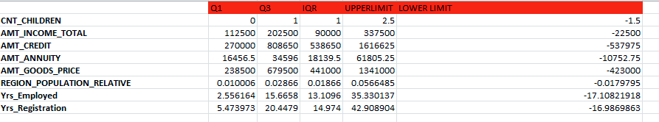
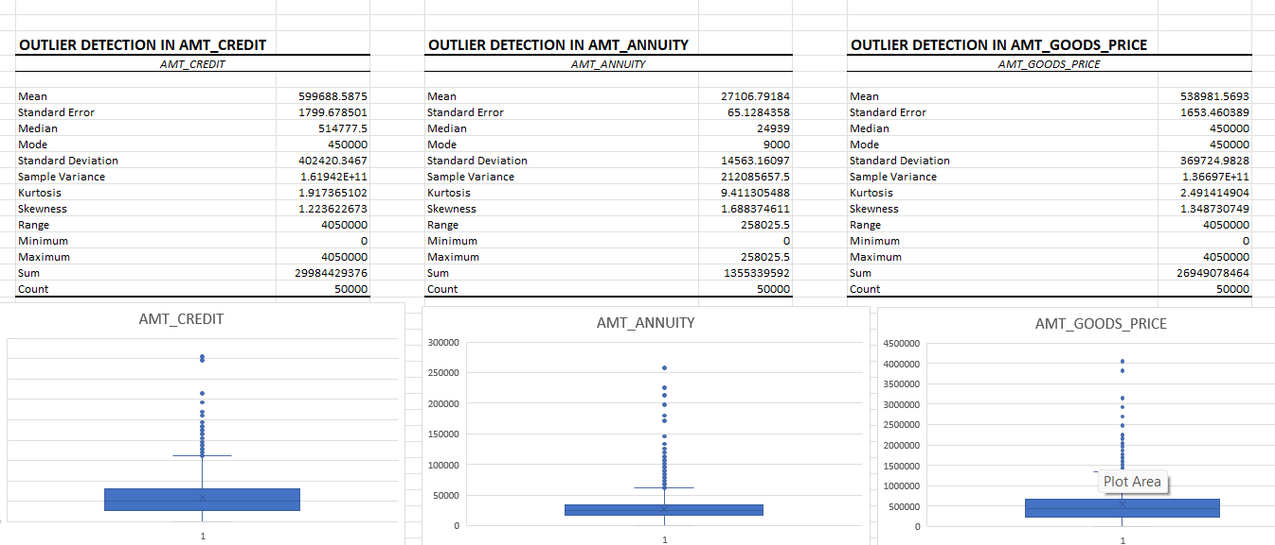
Identify Outliers
outliers are data points which deviate from the majority of the data
Once I got the cleaned data, filtered out columns to detect outliers ,taken out selected columns
with the help of excel functions like quartile calculated Q1,Q3,IQR,upper &lower limit
For all the detected columns, I calculated descriptive statistics and also to visually understand used box plots or scatter plots to visualize the distribution of numerical variables and to highlight the outliers

Slide 9
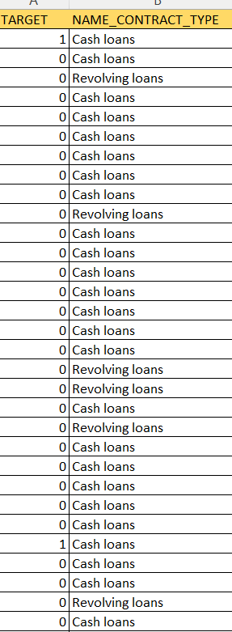
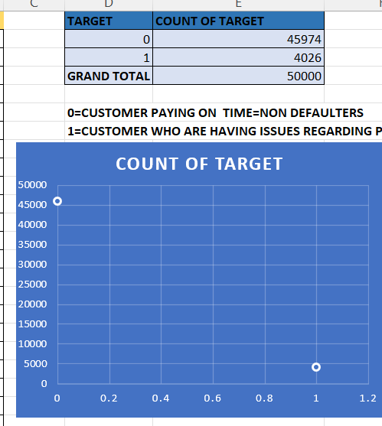
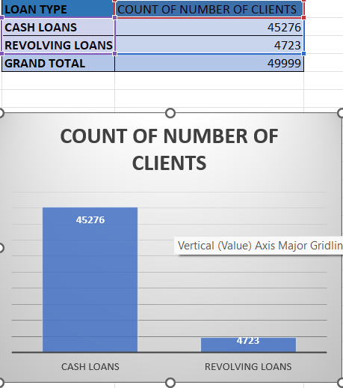
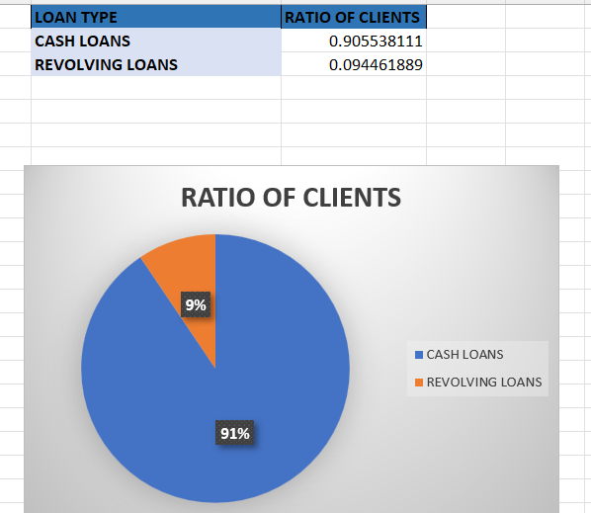
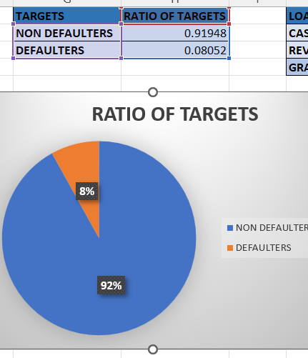
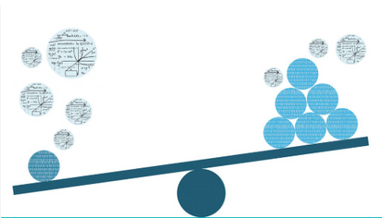
A
N
A
L
Y
S
E
I
M
B
A
L
A
N
C
E
D
A
T
A

Slide 10
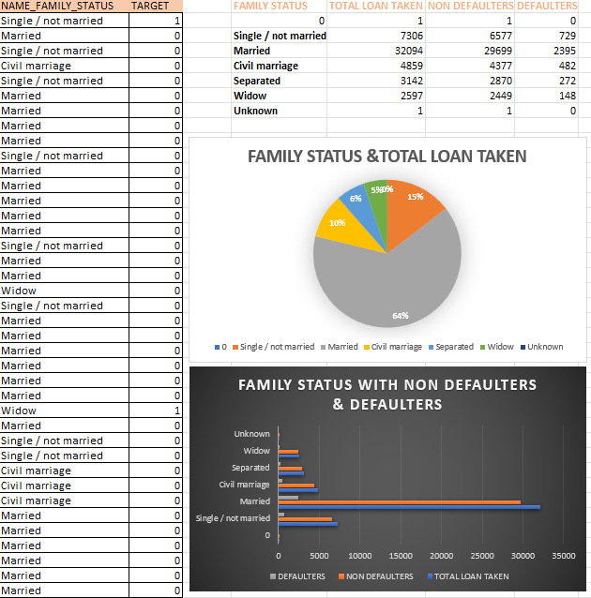
Univariate Analysis means the analysis of a single variable (or column) in a dataset
Here I’ve took the columns which uniquely has values
I’ve found 4 columns as such
CODE_GENDER
NAME_FAMILY_STATUS
NAME_EDUCATION_TYPE
OCCUPATION_TYPE
and done filtered out column to know variables and calculated total, non defaulters & defaulters with countif and also used graphical tool to understand more precisely

Slide 11
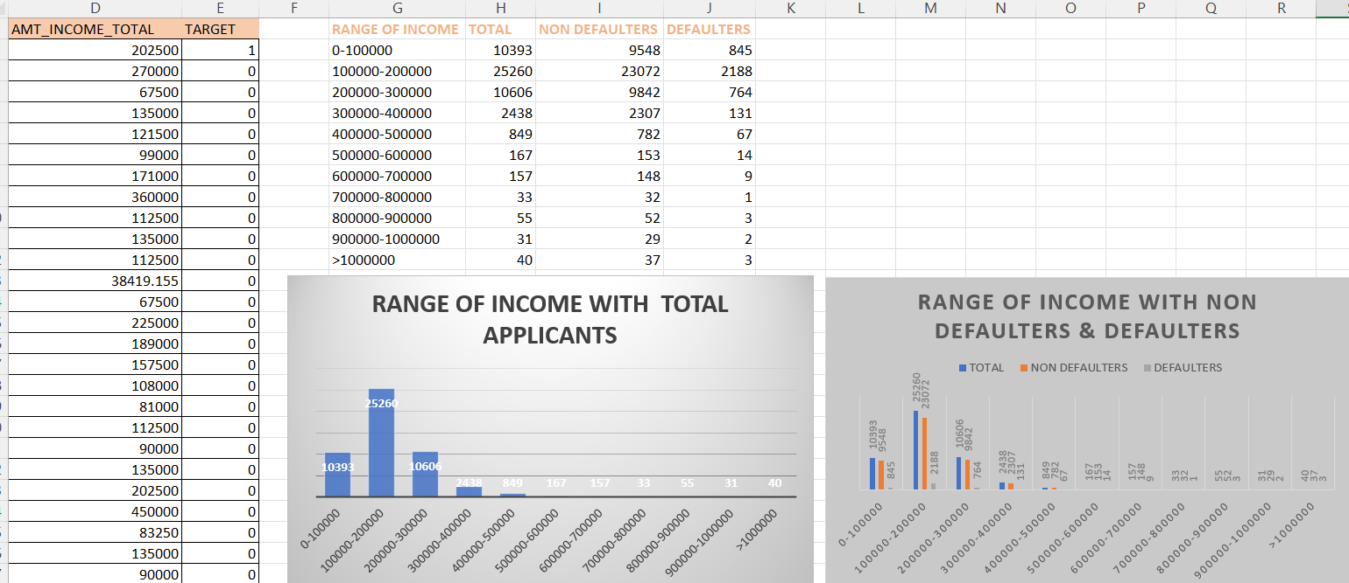
Segmented Univariate analysis can be used to find summary of a single data variable in form of segments/groups.

Slide 12
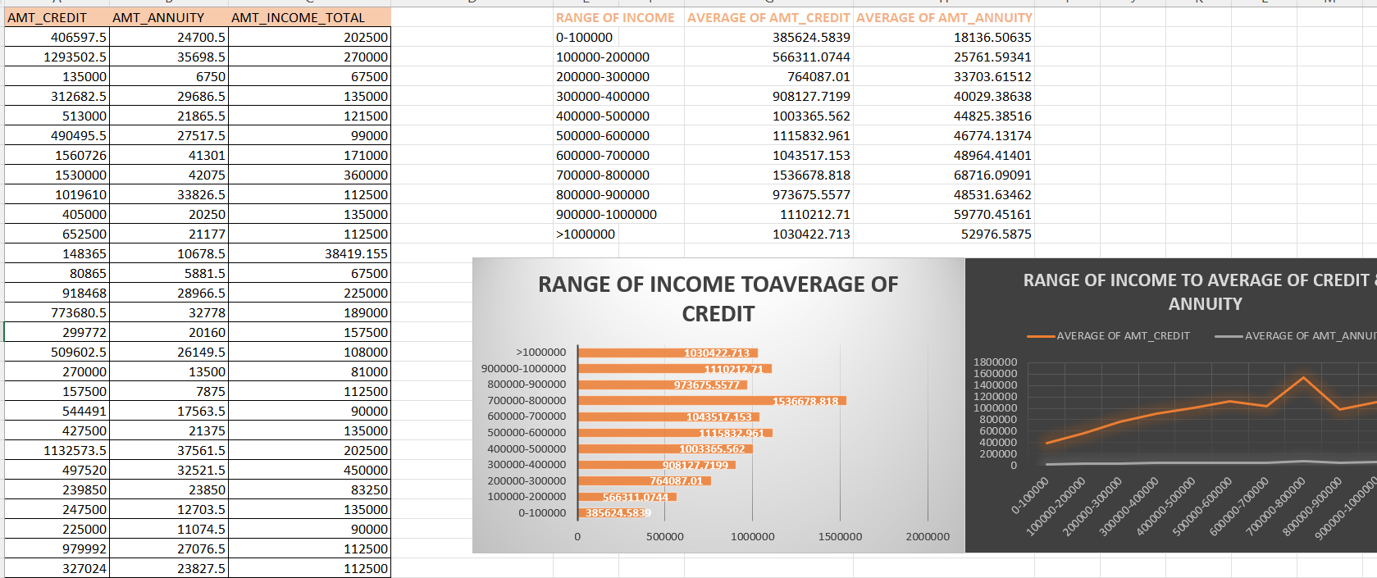
Bivariate analysis is a statistical method used to investigate the relationship between two variables.
Here client total income ,annual income & amount of credit is interlinked calculated average with average excel function &used clusted bar &line chart to represent data

Slide 13
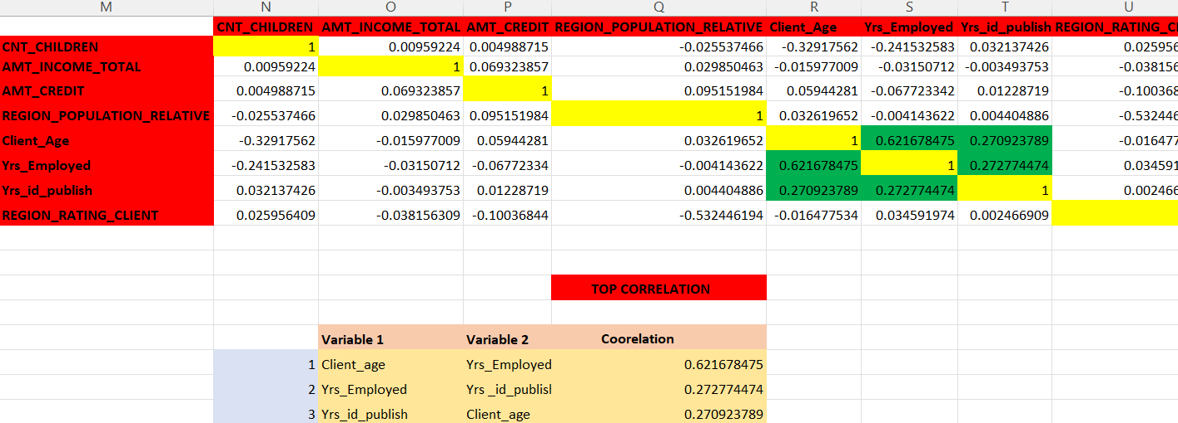
Top Correlations for Different Scenarios
Scenario:1
we’ll select some of the columns with target column to find out correlation between them, first with non defaulters(0)who are paying on time
calculated correlation with excel function CORREL(Array1,Array2) and found out top 3 correlation
Highlighted perfect positive correlation as well as next top 3 correlations

Slide 14
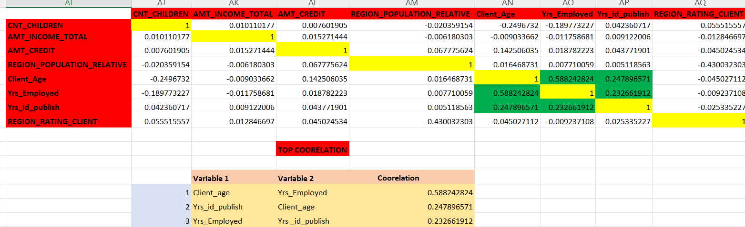
scenario 2:
we’ll select some of the columns with target column to find out correlation between them, next with defaulters(1)who are having issues regarding payment
calculated correlation with excel function CORREL(Array1,Array2) and found out top 3 correlation
Highlighted perfect positive correlation as well as next top 3 correlations

